Slide 1
AI powered automated patient documentation and prescription software
PIP2001 Capstone Project
Review-0
Batch Number: CAI-G19
Roll Number | Student Name
20211CAI0080 | R KESHAV
20211CAI0087 | RAKSHITHA KT
20211CAI0109 | S SRINIVAS
20211CAI0112 | SHOVIN WILSON AW
20211CAI0187 | PREM JE KALISTER
Under the Supervision of
Dr. AKSHATHA Y
Assistant Professor
School of Computer Science and Engineering
Presidency University
Name of the Program: B.TECH Computer Science and Engineering (AIML)
Name of the HoD: Dr. Zafar Ali Khan
Name of the Program Project Coordinator: Dr. Afroz Pasha
Name of the School Project Coordinators: Dr. Sampath A K / Dr. Abdul Khadar A / Mr. Md Ziaur Rahman

Slide 2
Content
Problem Statement
Github Link
Analysis of Problem Statement
Timeline of the Project
References

Slide 3
Problem Statement Number: PSCS45
Organization: Max Healthcare
Category (Hardware / Software / Both) : Software
Problem Description: Need to Increase facetime between clinicians and
patients. Clinicians spend considerable amount of time capturing patient
information in hospital software. Need a technical solution like speech to text
option.
Difficulty Level: Complicated

Slide 4
Github Link
The Github link provided should have public access permission.
Github Link
https://github.com/Sake-Srinivas/Capstone-Project

Slide 5
Analysis of Problem Statement
Technology Stack Components:
Languages: Python
Libraries: soundfile, librosa, torch, transformers, pyannote, huggingface
torchaudio etc.
Large Language Models: wav2vec-base-960h , GPT 3.5 Turbo.
Database: MySQL, MongoDB
Interface: Streamlit/Flask, HTML, CSS

Slide 6
Analysis of Problem Statement (contd...)
Software and Hardware Requirements:
Operating System: Windows 10/11
RAM: Minimum 4GB, Recommended 8GB and above
Processor: Intel i3/AMD Ryzen 5 and Above
IDE: Jupyter Notebook, Visual Studio Code, GitHub Codespaces.
Cloud Computing: Google Collaboratory
Storage: Google Cloud

Slide 7

Analysis of Problem Statement (contd...)
Doctors face challenges managing vast patient data in EHRs (Electronic Health Records). While EHRs capture basic demographics, they don't assist with complex documentation during each visit. Shifting through lab results and updates takes time, reducing face-to-face interaction with patients.
Concerning issues:
Time-consuming Documentation: Doctors spend significant time documenting patient information, limiting time for patient care.
Data Overload: Physicians manually extract data from complex EHRs, further slowing their workflows.
Complex Medical Terminology: Documentation involves technical terms derived from multiple tests, complicating the writing and typing process.

Slide 8
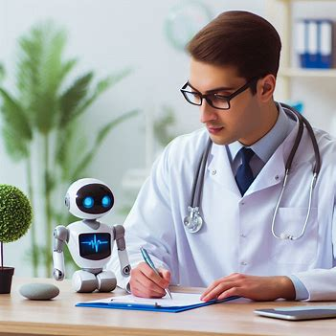
Analysis of Problem Statement (contd...)
Proposed Solution:
Speech-to-Text Integration: Capture live conversations between doctors and patients, extracting essential details in real time.
AI-Powered Summarization: Use Generative AI (e.g., GPT) to mine and summarize patient records, reducing the time spent on data extraction.
Additional Input: Doctors can add supplementary information via voice, reducing manual entry efforts.

Slide 9

Analysis of Problem Statement (contd...)
Outcome:
Increased Face Time: By automating documentation, clinicians can focus more on patient care.
Universal Access: A unique patient ID will allow for seamless access to patient records across hospitals.
Improved Workflow: Streamlined documentation processes lead to faster and more efficient care delivery.

Slide 10
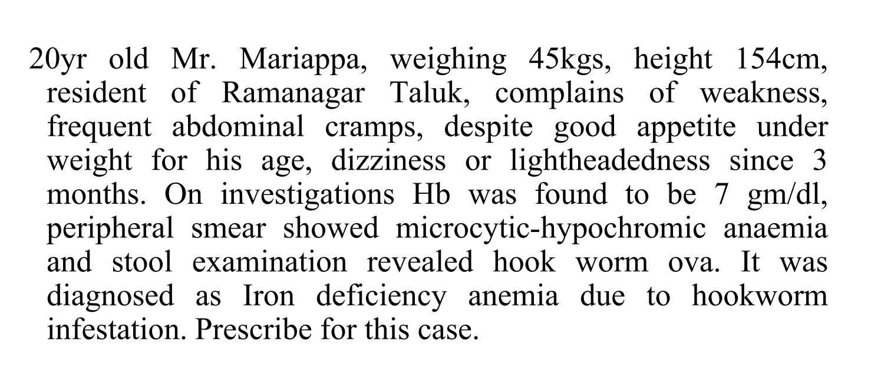
Sample Documentation

Slide 11




Process of Documentation
Consulting
Lab Reports
Manual Inputs
Documentation

Slide 12
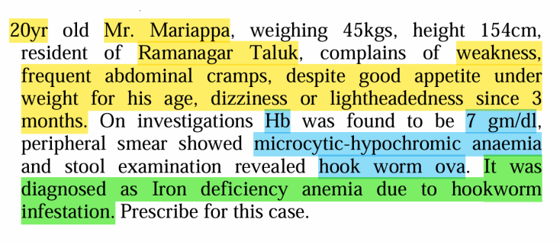
Consultation Lab Reports Manual Inputs

Slide 13
Live Audio Transcript
"So, Mariappa, how have you been feeling lately?" "I've been having a persistent cough for about a week, and it's making me feel really weak," "Any fever or shortness of breath?" "No fever, but sometimes I feel a bit out of breath after walking," "Do you have any history of asthma or allergies?" "No, none that I know of, but I do have iron deficiency anemia," "Alright, let me listen to your lungs. Take a deep breath," After a brief examination, the doctor noted, "Your lungs sound clear, but I’ll order a chest X-ray just to be sure. I’ll prescribe you some cough medicine and adjust your iron supplements. If the cough doesn’t improve, come back, and we’ll investigate further."

Slide 14
Speaker Mapped Diarization
Doctor: "So, Mariappa, how have you been feeling lately?"
Mariappa: "I've been having a persistent cough for about a week, and it's making me feel really weak."
Doctor: "Any fever or shortness of breath?"
Mariappa: "No fever, but sometimes I feel a bit out of breath after walking."
Doctor: "Do you have any history of asthma or allergies?"
Mariappa: "No, none that I know of, but I do have iron deficiency anemia."
Doctor: "Alright, let me listen to your lungs. Take a deep breath."
Doctor: "Your lungs sound clear, but I’ll order a chest X-ray just to be sure. I’ll prescribe you some cough medicine and adjust your iron supplements. If the cough doesn’t improve, come back, and we’ll investigate further."
Mariappa: "Thank you, Doctor."

Slide 15
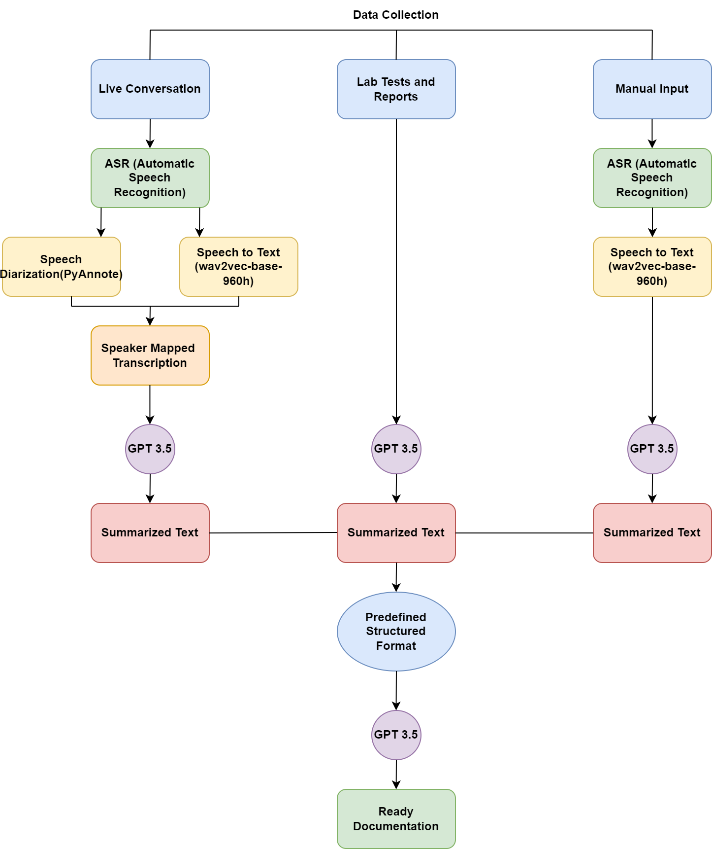

Slide 16
Timeline of the Project (Gantt Chart)
Collecting Training Data
Training the Model
Speech Diarization
Speaker Mapped Transcription
Phase 2(Mid Oct-Mid Nov)
Summarizing the Mapped Transcript
Summarizing Lab Reports
Speech to Text Summarization of Manual Inputs
Creating and training to fit the summarization on defined format
Generating the pdf
Creating the user interface store and access management through database
Prescription AI
Phase 1(Mid Sept-Mid Oct)
Phase 3(Mid Nov-Mid Dec)

Slide 17
References (IEEE Paper format)
1) M. M. Kabir, M. F. Mridha, J. Shin, I. Jahan and A. Q. Ohi, "A Survey of Speaker Recognition: Fundamental Theories, Recognition Methods and Opportunities," in IEEE Access, vol. 9, pp.79236-79263, 2021, doi: 10.1109/ACCESS.2021.3084299.
2) Sarah Levine, Hsiaolin Hsieh, Emily Southerton, Rebecca Silverman, How high school students used speech-to-text as a composition tool, Computers and Composition,Volume 68,2023,102775,ISSN 8755-4615,https://doi.org/10.1016/j.compcom.2023.102775.
3) Jun Zhang, Jingyue Wu, Yiyi Qiu, Aiguo Song, Weifeng Li, Xin Li, Yecheng Liu, Intelligent speech technologies for transcription, disease diagnosis, and medical equipment interactive control in smart hospitals: A review,Computers in Biology and Medicine,Volume 153,2023,106517,ISSN 0010-4825,https://doi.org/10.1016/j.compbiomed.2022.106517.
4) Johnson, S.J., Murty, M.R. & Navakanth, I. A detailed review on word embedding techniques with emphasis on word2vec. Multimed Tools Appl 83, 37979–38007 (2024). https://doi.org/10.1007/s11042-023-17007-z.

Slide 18


